Slide 1






ITCS/DSBA 6100
Final Project Presentation
Team 4
Predicting Loss Ratios for Auto Insurance Portfolios
Aditya Kamble
Urma Haldar
Niraj Bista
Mike Teague
Notes:
Welcome to Team 4’s project presentation on Prediction Loss Ratios for Auto Insurance Portfolios.
Our team members are:

Slide 2
Agenda
Agenda
Introduction
Domain Knowledge
Preprocessing
Modeling
Evaluation
Conclusions
EDA
Notes:
First we’ll introduce our project and background behind it
We’ll then briefly discuss our employment of Domain Knowledge
As well as our use of Exploratory Data Analysis
We’ll also share our methods used during data preprocessing
Followed by an explanation of the modeling techniques we employed
And finally we’ll share our overall evaluation and conclusions for the project

Slide 3
Problem
50% of all policies
Can be Mispriced by more or Less than 10%
(up to 50%)
In the Insurance Industry…
Notes:
The problem in which our project seeks to resolve is one which is common in the Insurance Industry, that is:
Can have implications on the profitability of insurance providers

Slide 4
Introduction
Historical dataset of around 400K input samples of Auto Insurance policies
64 input features (ex. vehicle make year, vehicle performance, usage, miles to work etc.)
Most of these input features were categorical.
Testing dataset of 330 policy portfolios
Each consisting of at least 1000 policies
Included almost all of features above EXCEPT those such as loss_amount.
Datasets
Notes:
Our project was provided two data sets for training and testing.
Our training dataset was…
Our Testing dataset

Slide 5
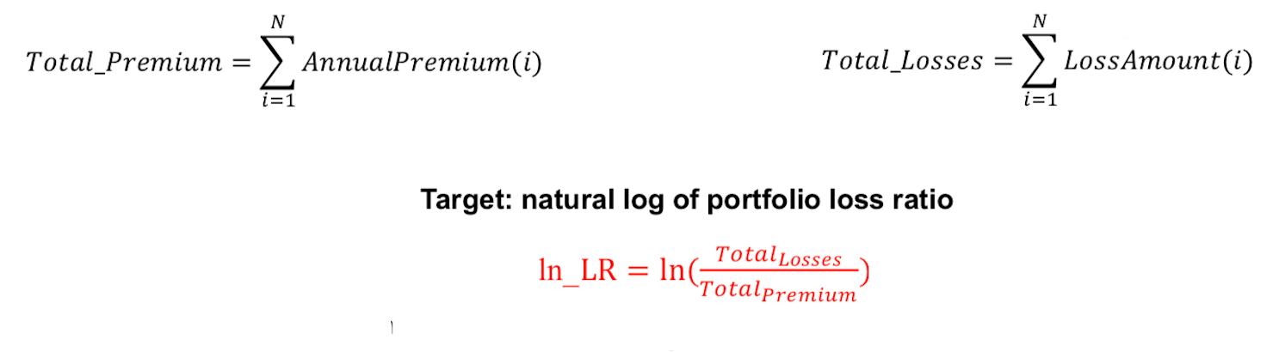
Introduction
Predict Missing Loss Amounts in Test Data
Find Natural Logarithm (ln_LR) of the loss ratio for each portfolio in testing dataset
Our Objective
Notes:
The objective our project was to first:
Predict the missing loss amounts in the testing data as just mentioned
Secondly:
We use that prediction to calculate the loss ration and natural logatrithm for the portfolios in our testing data set.

Slide 6
Goal
Create a competitive advantage for an Insurance Provider by developing a model(s) capable of predicting the loss ratios of policy portfolios, which will enable them to more accurately access the overall risk of a given portfolio as well as make better informed decisions on premium rates.
Notes:
This brings us to the overall goal of our project:
Create a competitive advantage for an Insurance Provider by developing a model(s) capable of predicting the loss ratios of policy portfolios, which will enable them to more accurately access the overall risk of a given portfolio as well as make better informed decisions on premium rates.

Slide 7
Project Workflow
EDA
Data Review
Data Preprocessing
Insurance Data
Domain Knowledge
Creating Portfolios of Training Data
Feature Creation
Choose Model & Develop
Predict Loss Amount on Insurance Data
Notes:
And finally, shown here is an overview of our project workflow, we’ll be discussing in detail

Slide 8
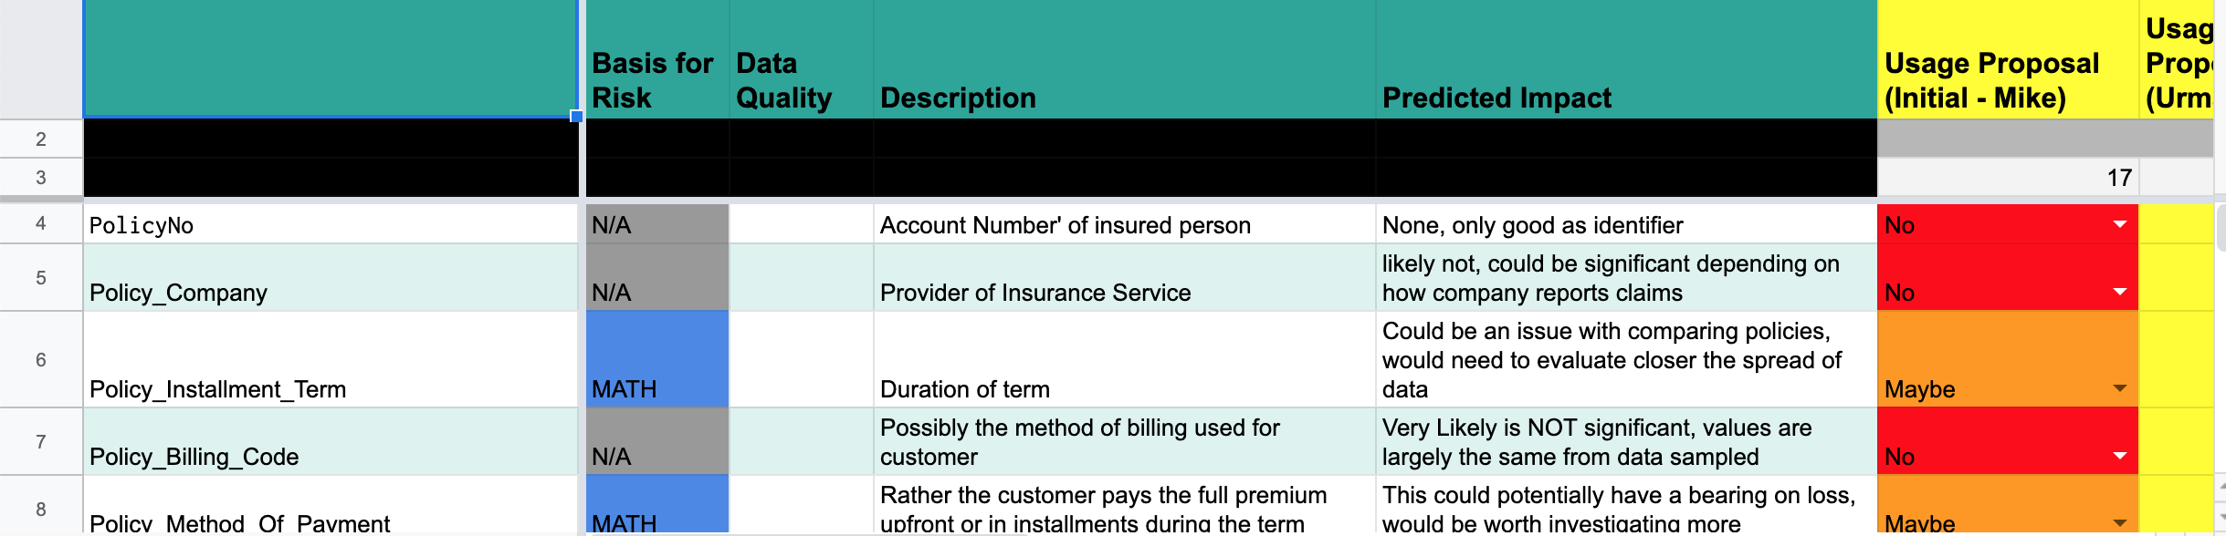
Domain Knowledge
Notes:
We began our project by further investigating each of the included features in our datasets to gain a better understanding of the information they provided. We then documented this information and utilized this resource to track the specific features used during our various modeling processes.

Slide 9
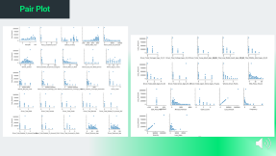
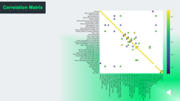
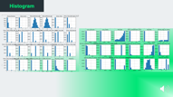


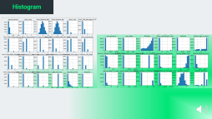
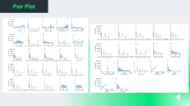
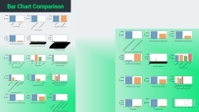
Exploratory Data Analysis
Notes:
Our next step was to conduct Exploratory Data Analysis on our data. To accomplish this we utilized four tools.

Slide 10
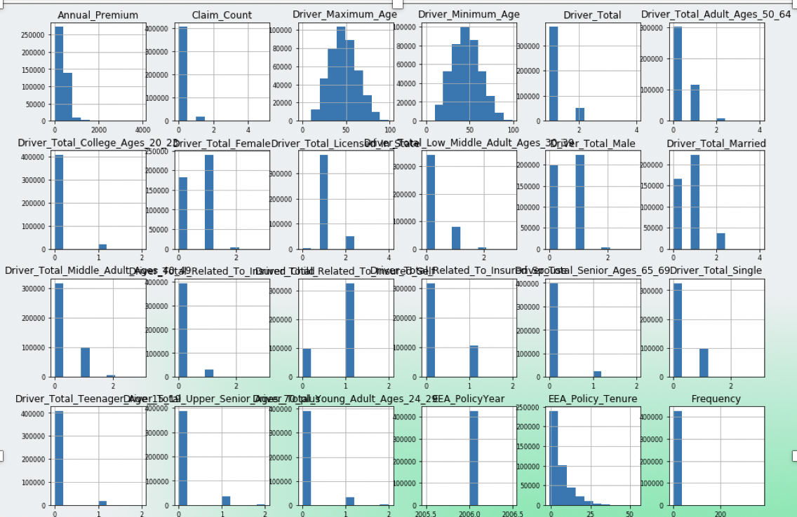
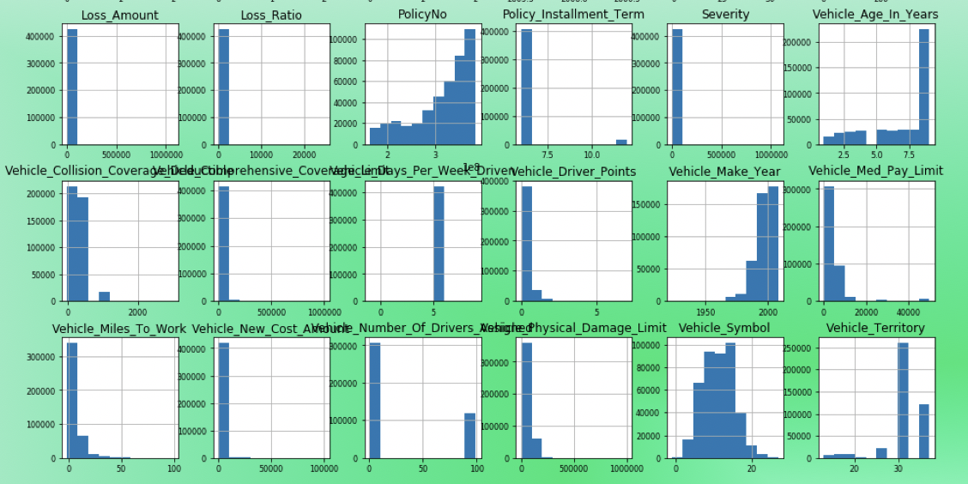
Histogram
Notes:
The Histogram provided a comparison of the distribution of each feature.
For example, this demonstrates that our data represents a large amount of middle age drivers based on the Driver max age feature

Slide 11
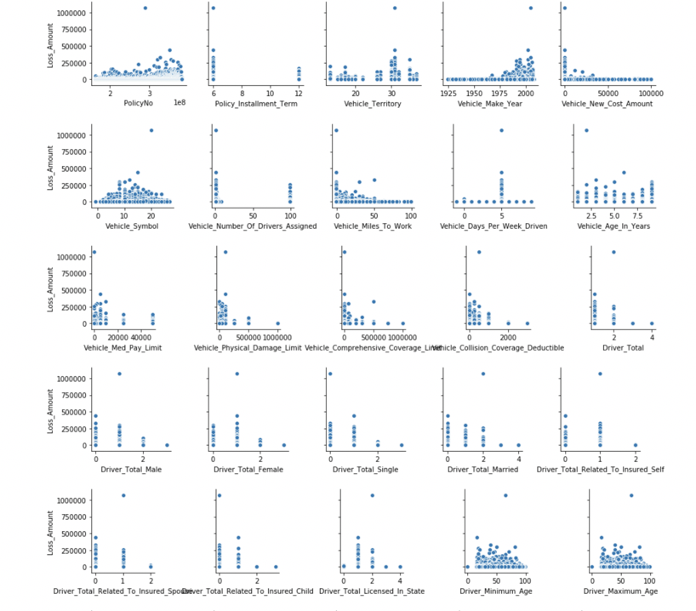
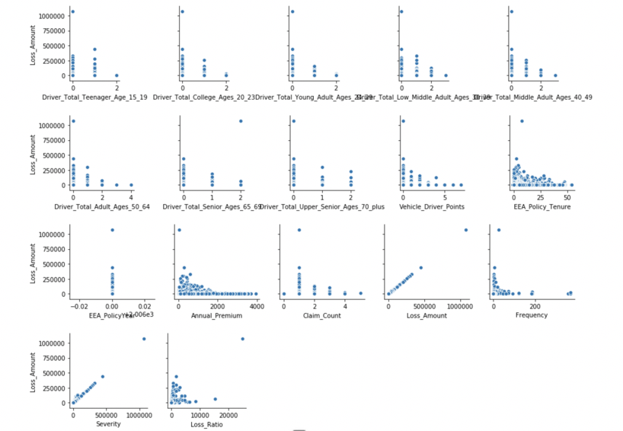
Pair Plot
Notes:
In the Pair plot we compared the relationship of each feature to the target variable, the’ loss_amount’

Slide 12
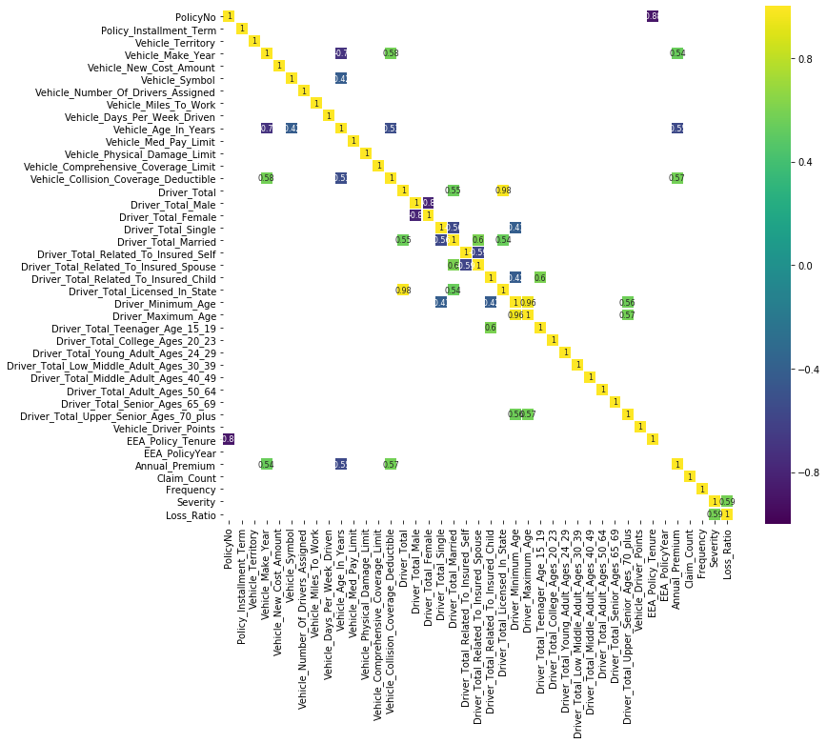
Correlation Matrix
Notes:
We used the Correlation Matrix to compare our features with each other
For example this told us that the driver_minimum_age feature is closely related to the ‘Total teenage drivers’ feature.

Slide 13
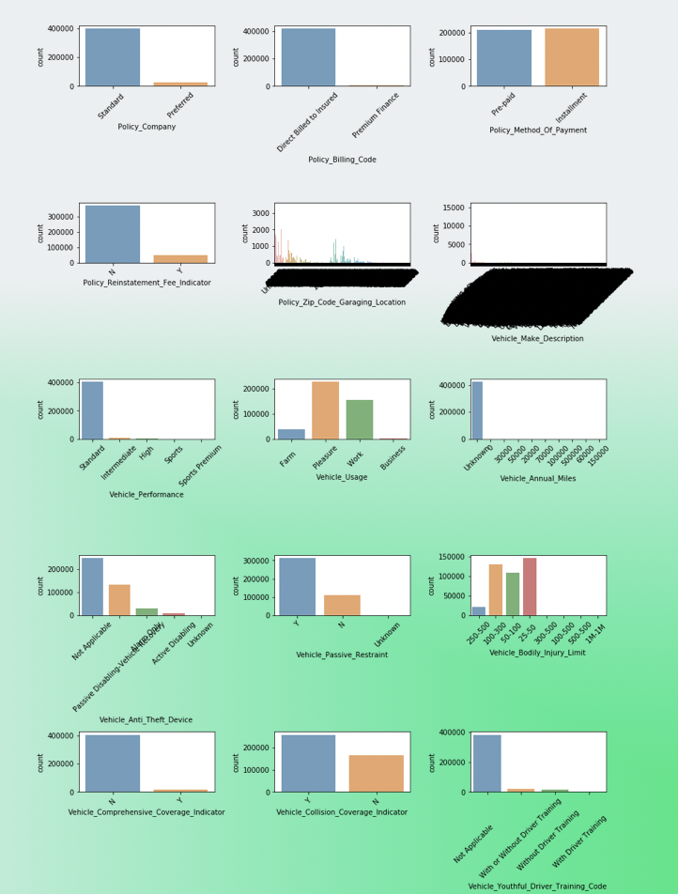
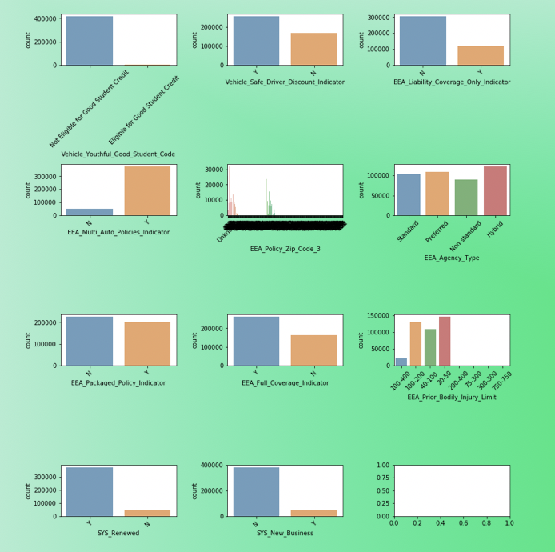
Bar Chart Comparison
Notes:
Lastly, we used Bar Chart comparisons to evaluate the various occurrences within each feature.

Slide 14
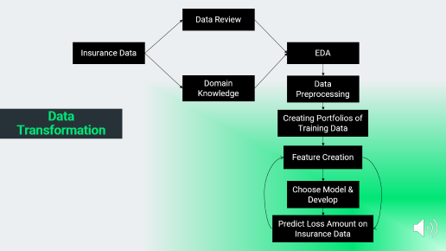
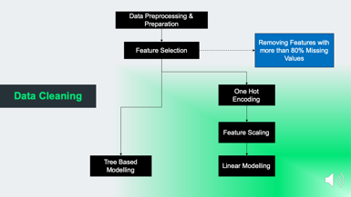


Data Preprocessing
Notes:
After completion of Exploratory Data Analysis, we then began our data preproccessing where we evaluated factors of missing data, imputations, scaling and other implementations.

Slide 15
Data Cleaning
Data Preprocessing & Preparation
Removing Features with more than 80% Missing Values
Feature Selection
One Hot Encoding
Feature Scaling
Tree Based Modelling
Linear Modelling
Notes:
We first performed data cleaning by:
Dropping all null values
Removing trailing white spaces
And eliminating features which consisted of more than 80% unknown values

Slide 16
Data Transformation
Data Review
Insurance Data
EDA
Domain Knowledge
Data Preprocessing
Creating Portfolios of Training Data
Feature Creation
Choose Model & Develop
Predict Loss Amount on Insurance Data
Notes:
We then conducted Data Transformations by:
-Merging existing features into new features. As an example we merged the various Age group features into fewer features
Additionally, we organized the training data set into portfolios using a similar approach to that used for the testing data set.

Slide 17
Modeling Techniques
Decision trees
Random Forest
Neural Networks
Ada Boost
XGBoost
Notes:
Once preparations were complete, we attempted both linear and tree-based modeling techniques.
During this process we discovered that Tree-based modeling techniques performed better due to the categorical nature of our features

Slide 18
Evaluation Methods
Splitting training portfolios into training and holdout sets
Calculated the Mean Absolute Error (MAE) on these new splits
Predicted loss amounts on our test portfolios using our model
Calculated the loss ratio and corresponding Natural Logarithm on the testing portfolios
Submitted results on Kaggle which provided a rank based on the MAE of our submission
Notes:
Finally, for our evaluation methods we
We first Split our training portfolios into training and holdout sets
We then calculated the Mean absolute error on these new splits
Loss amounts in our testing portfolios were then predicted using our model
These predictions were then used to calculate the loss ratio and corresponding natural logarithm of the portfolios
Finally, these values were then submitted on Kaggle which provided a rank based on the Mean Absolute Error of our submission.

Slide 19
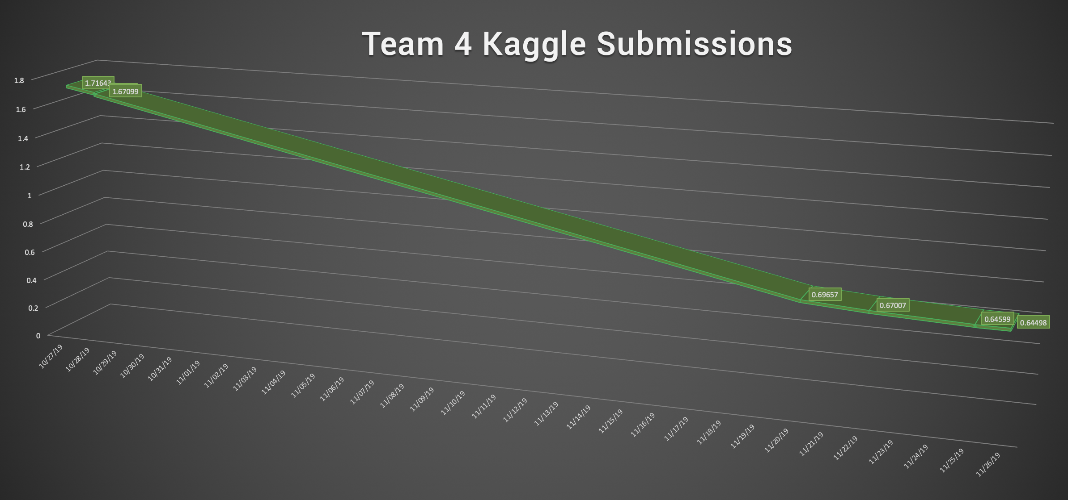
Evaluation Methods
Notes:
As can be seen here, the mean absolute error of our submissions on Kaggle improved significantly over the duration of our project and our best scores fell below the baseline of the public leaderboard

Slide 20
Conclusions
Statistical modeling offers a unique competitive advantage in many industries…
It offers a notable advantage for the Insurance Industry.
Notes:
In Conclusion, We believe that statistical modeling offers a unique competitive advantage in many industries, but in particular the insurance industry.
We feel that this project has exemplified this advantage in a compelling way by further demonstrating the enhanced capabilities of analyzing risk and profitability using data science.

Slide 21

Thank You!
Notes:
On behalf of our team we hope you have enjoyed our presentation and found it insightful. thank you for watching!

